Slide 1
🕹 Quiz Game GUI Project
Dipu Mondol (ID: IT-24040) Limon Hasan (ID: IT-24041)
Adviser: Mr. Ziaur Rahman (Associate Professor)
Department of Information and Communication Technology (ICT)
Mawlana Bhashani Science and Technology University

Slide 2
Project Overview
• Project Name: Quiz Game
• Platform: GUI Red Studio 13
• Language: C++
• Type: Interactive Quiz Application
• Features: Multiple choice, scoring points, automatic question loading

Slide 3
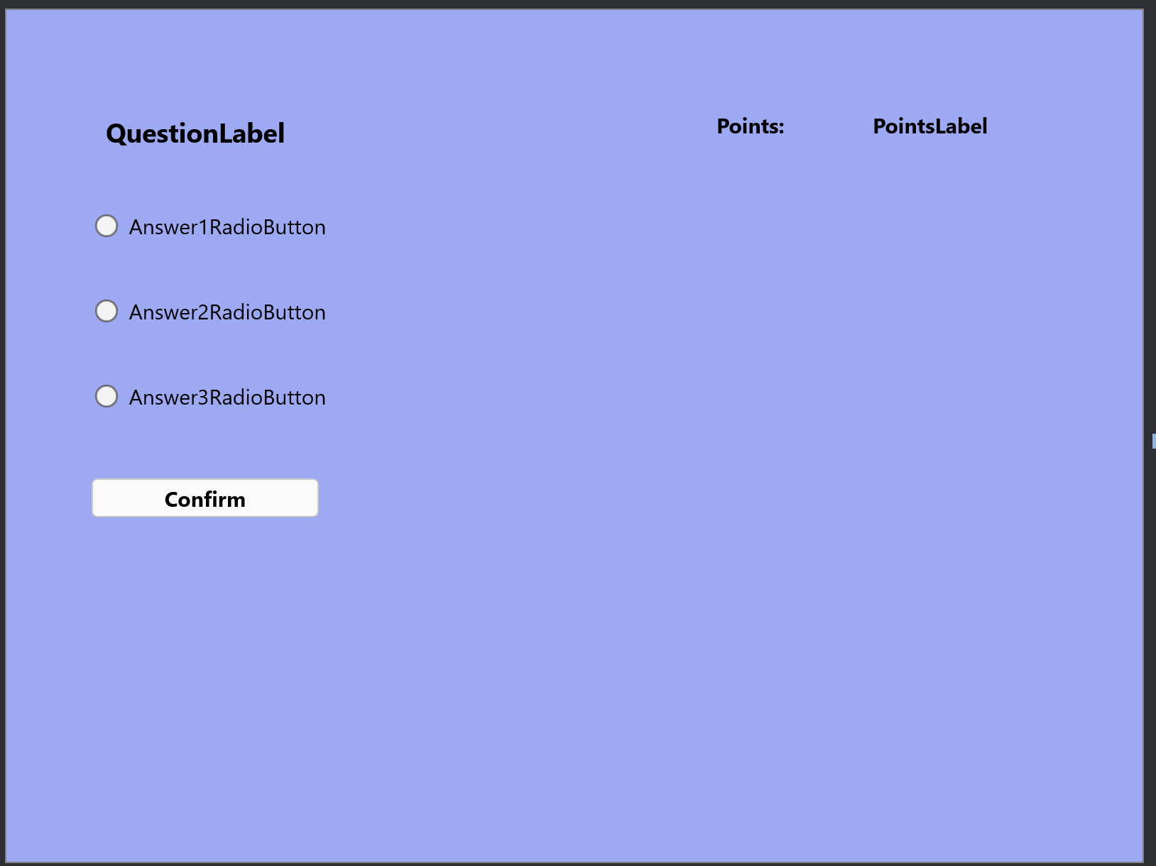
GUI Preview
• Clean, spacious layout with left-aligned questions and easy-to-click radio buttons.
• Confirm button for submission and a visible Points display.
• Designed for usability: large touch targets and clear feedback.
•The Interface:

Slide 4
Code (Part 1)
// Core question class
class question{
public:
char* Text;
char* Answer1;
char* Answer2;
char* Answer3;
int CorrectAnswer;
};

Slide 5
Code (Part 2)
// Sample LoadQuestions implementation (questions pushed to queue)
std::queue<question> LoadQuestions() {
question q1 = question("Which color does not appear in Olympic rings?", "Black", "Orange", "Green", 2);
// ... q2 .. q10
std::queue<question> questions;
questions.push(q1);
// push remaining questions
return questions;
}

Slide 6
Main Logic & Handlers
// Global variables
std::queue<question> questions;
question currentQuestion;
int selectedAnswer = 0;
int Points = 0;
// On form create: load questions and set first question texts
// Radio button change handlers set selectedAnswer to 1/2/3
// ConfirmButtonClick:
if(selectedAnswer == currentQuestion.CorrectAnswer) { Points++; PointsLabel->Text = Points; }
if(!questions.empty()) { load next question... } else { ConfirmButton->Enabled = false;
ConfirmButton->Text = "The End"; }

Slide 7
Sample Questions
1. Which color does not appear in Olympic rings? (Black/Orange/Green)
2. What is the chemical formula of table salt? (NaCl)
3. Which planet is known as the Red Planet? (Mars)
4. Who wrote 'Romeo and Juliet'? (William Shakespeare)
5. What is the hardest natural substance on Earth? (Diamond)

Slide 8
User Interaction Flow
1) App starts -> LoadQuestions() fills queue.
2) Display currentQuestion and options.
3) User selects an option (radio buttons).
4) User clicks Confirm -> check correctness, update Points.
5) Queue pops and next question loads until empty -> Show 'The End'.

Slide 9
Conclusion
✅ Successfully developed a C++ GUI Quiz Game
✨ Implemented modern UI
🧠 Demonstrated logic and event handling
🚀 Built with Red Studio 13

Slide 10
✨ THANK YOU FOR YOUR ATTENTION

